Slide 1
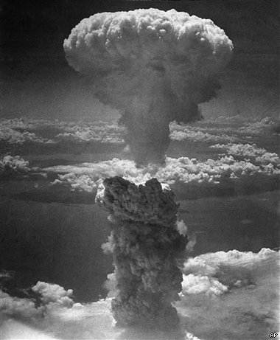
Module B: Ways of Thinking
After the Bomb

Slide 2
From the syllabus
The module requires students to explore and evaluate a selection of texts relating to a particular historical period.
It develops the ways in which scientific, religious, philosophical or economic paradigms have shaped and are reflected in literature and other texts.
Students explore the ways values are inscribed in and reflected by texts.

Slide 3
After the Bomb
In this elective students explore texts from the dropping of the atomic bombs on Hiroshima and Nagasaki and up to the collapse of the Soviet Union and dismantling of the Berlin Wall (1945-89)
A climate of Cold War anxiety these texts in a number of ways. The texts may emerge from, respond to, critique, and shape our understanding of ways of thinking during this period. Many of these texts have a common focus on the personal and political ramifications of this era.
They often are characterised by an intensified questioning of humanity and human beliefs and values.
Experimentation with ideas and form may reflect or challenge ways of thinking during this period.

Slide 4
The Texts
Students are required to study at least three of the prescribed texts as well as two related texts of their own choosing.
Prescribed texts:
Ariel – Sylvia Plath
Waiting for Godot – Samuel Beckett
The Spy Who Came in from the Cold – John Le Carre
Texts should be drawn from a range of contexts and media and should reflect the personal and political concerns of the post-war period.

Slide 5
Some features of Cold War history and culture
The term ‘cold war’ underlines both a lack of overt war and intense conflict between extremes in politics and ideology. The period includes:
Rivalry for world power.
The development of extreme political and ideological positions (late Western capitalism vs. communism).
Local, proxy wars across the world (Korean, Vietnam and Afghanistan wars).
Threat of nuclear annihilation (nuclear holocaust)
Space race/arms race.
Widespread use of espionage.
Govt. fear and anxiety about dissent, subversion and invasion.
Govt. suppression and persecution of dissent in USSR and US.

Slide 6
Some features of Cold War history and culture
Widespread propaganda including celebration of national belief and identity and a view of the enemy as monstrous, alien and inhuman as conveyed in mass culture.
In contrast to Cold War anxiety, post-war renewal, prosperity, consumerism, celebration of suburban society.
Continuation of the mid-twentieth century intellectual tradition of existentialism with the addition of post-atomic war end of the world anxiety.
Fear of general direction to totalitarian govt. and culture (1984) in West and Communist Eastern bloc.
Rebellion and wildness in culture – Jack Kerorac/Beat Generation, Elvis Presley/Rock and Roll in opposition to tradition, order, conventional politics and suburban conformity.
Wider history of postmodern period and its concern with the failure of traditional civilisation and Western rationalism and interest in change, new technologies and new possibilities for culture, society and identity.

Slide 7
Frameworks for reading the texts
1. The atomic bomb and the threat of total annihilation, the end of WWII, threat of extinction of humanity, human values and belief systems, postmodern concerns and values of beliefs. (Beckett)
2. Cold War: political ideologies and systems; communism, totalitarianism, capitalism, containment, McCarthyism, the fear of the Domino effect, propaganda, hyperawareness. (Le Carre)
3. Cold War: the personal, individual and culture. Existentialism, alienation, disillusionment, rebellion vs. postwar reconstruction and optimism, suburban utopia, merging of high and mass culture (Plath).

Slide 8
Some Key Terms
Cold war
Containment (of Communism)
McCarthyism
Détente
Perestroika
Glasnost
Existentialism
Alienation
disillusionment

