Slide 1
Crime Writing
Genre and the Prescribed Texts
Karen Yager – Knox Grammar
Prue Greene – DET State Office

Slide 2
The Approach
‘How changing contexts and values have brought about changes in the traditional crime stories and resulted in new conventions’
‘unlimited combinations, subversions and transformations of the classic 'whodunit' murder mystery’

Slide 3
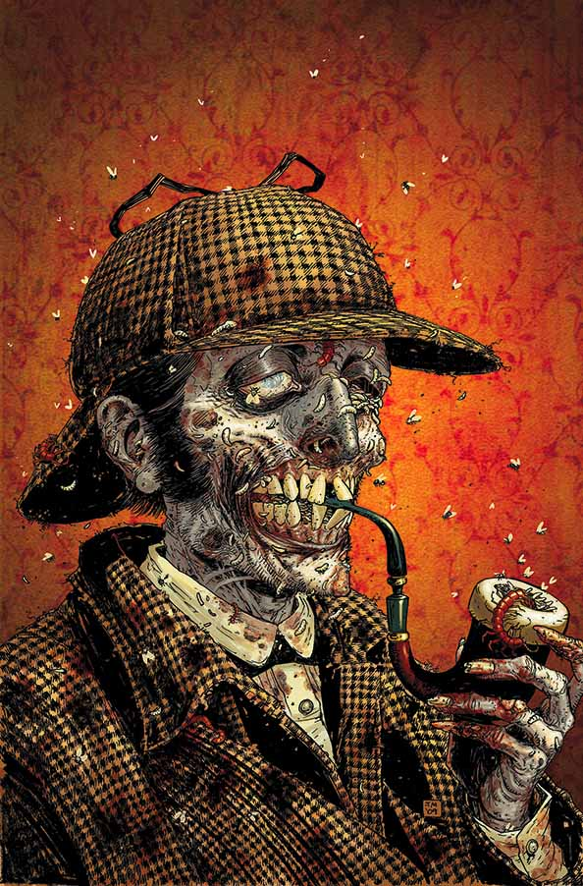
The Approach
Constants and differences
Audience and purpose
Ask how and why
Genre theory: genres evolve to reflect their times: ideology, values, the stories, technological changes…

Slide 4
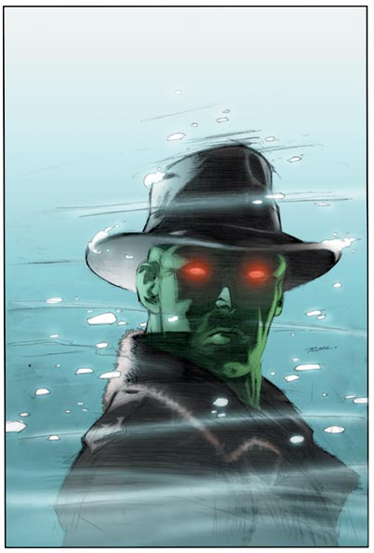
The Approach
‘How crime writing has evolved by extending, reimagining and challenging the conventions of the traditional detective story’
‘The crime and the investigation’
The medium, form, conventions, plot devices, setting, characters and ideas
The craft and artistry of writing

Slide 5
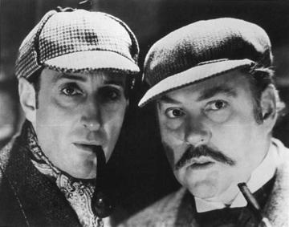
The Approach
‘account for the increasing popularity of different forms of crime writing while the traditional detective stories continue to retain their appeal’
Mystery and mayhem
Chaos and order
Diversity of crime
Mediums of production
Vulnerability and mortality
Exposure

Slide 6
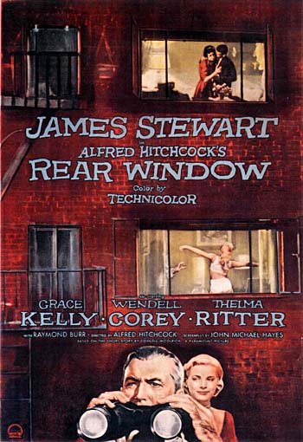
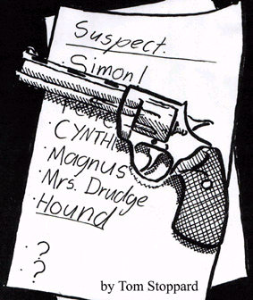
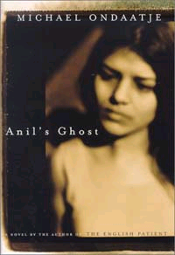
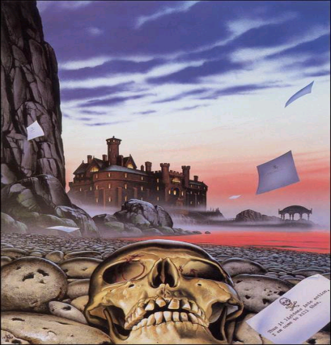
The HSC Examination
Sustained thesis or line of argument
Judicious textual support:
Detailed and relevant references to your prescribed texts and texts of own choosing
Key scenes and incidents used to explore constants and differences, plot, ideas, characters, setting, meaning and genre

Slide 7
HSC Examination
Integrated response:
Genre theory, context, values and perspectives
Meaning: What, why, how and impact
Relationships: Making connections with the texts through the thesis
Synthesis: The ideas and understanding you have gained from your exploration and close study of a range of texts and examination of genre theory

Slide 8
The Clues
“effective integration of texts to advance the overall thesis of the critical response”
“In English Extension 1, synthesis is greatly valued. In some responses texts and arguments were woven seamlessly”
“relevant understanding of literary theory, historical background and context”
“insightful awareness and discussion of ‘how’ ideas, concepts and meaning are shaped in texts.”
“a high level of personal and intellectual engagement with texts”
Notes from the Marking Centre

Slide 9
The Clues
“Competent answers identified traditions in chosen texts and asserted differences between texts as examples of innovation.”
“In stronger responses, candidates demonstrated a deep understanding of the genre as an ongoing reflection of society and its relationship with those who transgress its laws. They made connections between their texts and the genre as a whole, rather than the more formulaic treatment of texts in isolation.”
Notes from the Marking Centre

Slide 10
The Marking Rubric
In your answer, you will be assessed on how well you:
demonstrate understanding of the conventions of the genre and the ideas and values associated with the genre
sustain an extended composition appropriate to the question, demonstrating control in the use of language.

Slide 11
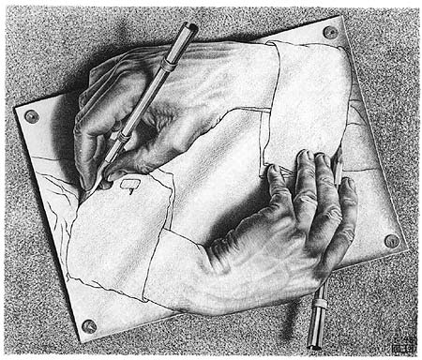
Genre Theory
“genres are instances of repetition and difference…difference is absolutely essential to the economy of genre” (Neale,1980).
“a means of constructing both the audience and the reading subject” (Fiske,1987).
Textual schemata
Genres “embody the crucial ideological concerns of the time in which they are popular” (Fiske,1987).

Slide 12
Genre Theory
“They rework, extend and transform the norms that codify them” (Neal, 1990).
Embryonic to classic (golden) to refinement (parodic and subversive)
“genres are about spectator-text relations as well as socio-historic relations” (Haywood, 2006)

Slide 13
Genre Theory
“any instance of a genre will be necessarily different” (Todorov).
“generically defined structures may operate to construct particular ideologies and values, and to encourage reassuring and conservative interpretations of a given text” (Casey, 1992).
“genre is... an intertextual concept” (Wales, 1989) – composer encodes and the responder decodes
“Genres can thus be seen as a kind of shorthand serving to increase the 'efficiency' of communication” (Fowler, 1989).

Slide 14
Values
The perspectives and intentions of the composer and his or her times shape the values or beliefs of the text.
Interrogate the values considering why they are evident in the texts and what they tell you about the composer and the times.
Recurrent values: truth, integrity, compassion, loyalty, honesty, justice…

Slide 15
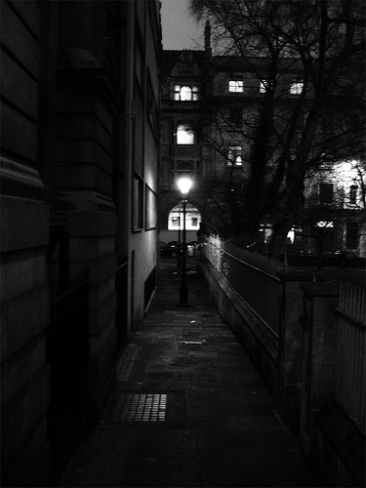
Meaning
“insightful awareness and discussion of ‘how’ ideas, concepts and meaning are shaped in texts”
How and why the meaning has been crafted and conveyed: the purpose, form, medium of production, textual details and features

Slide 16
Anil’s Ghost
“The new novel hasn't so much raised the bar on the forensic thriller as moved it to another place entirely. He bends and stretches the novel into marvellous shapes, building cathedrals of story, mysterious and grand adventures of the everyday” (www. Dave Weich.Powells.com).
“Yet the darkest Greek tragedies were innocent compared with what was happening here. Heads on stakes. Skeletons dug out of a cocoa pit in Matale”

Slide 17
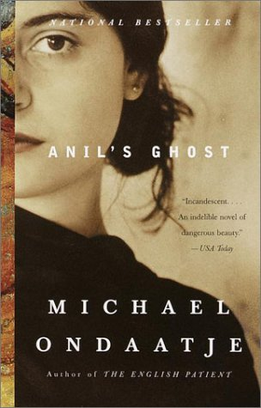
Anil’s Ghost – Form
Transformation through the focus on lived experience and human frailty rather than the crime
A post-modern text that challenges the conventional form of the novel and the crime genre: no closure, vignettes, polyphony of voices…

Slide 18
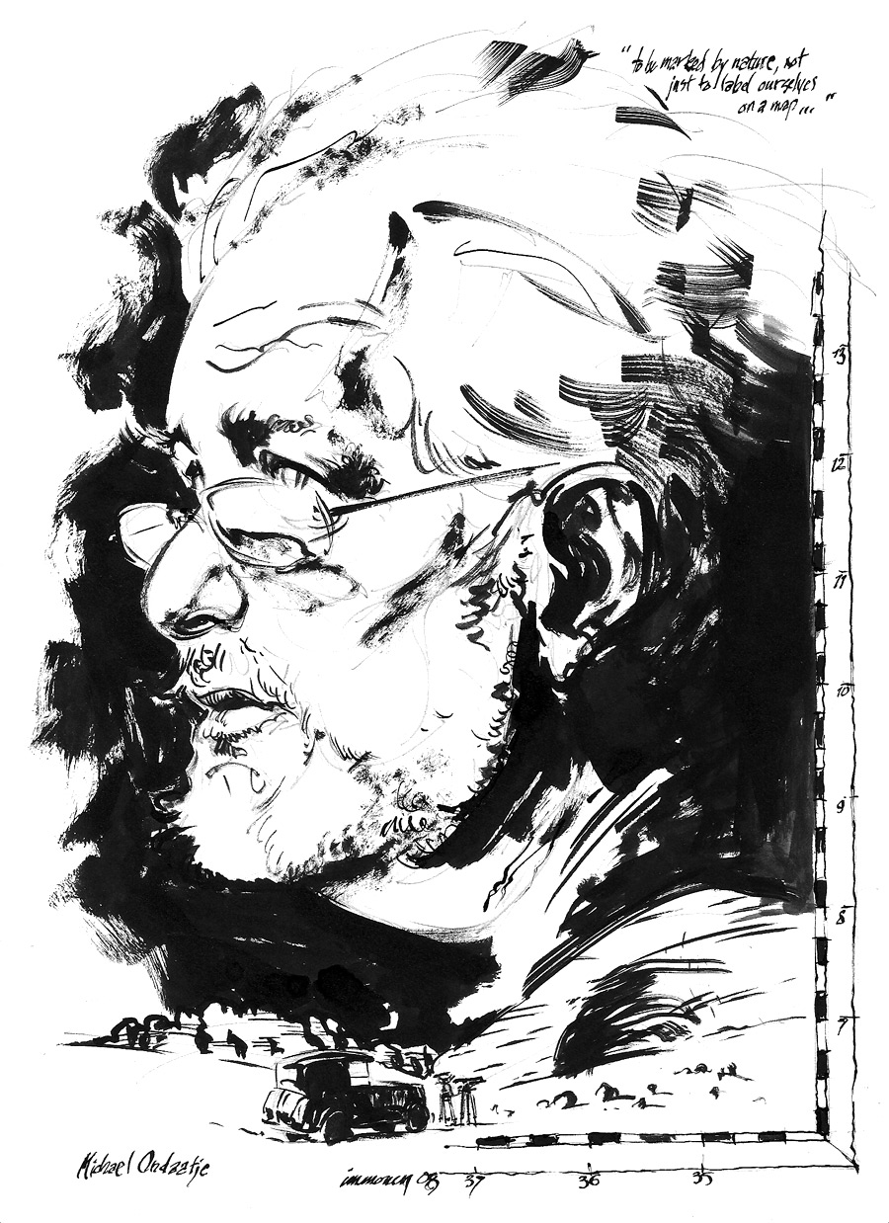
The Writer
Born in Colombo, Sri Lanka in 1943. Of Tamil, Sinhalese and Dutch descent – horrified by the violence in such a beautiful setting against a backdrop of Buddhism
His mother’s gift was her enthusiasm for the arts
Enigmatic father – “trying to find the central character…became a habit. In all my books there are mysteries that are not fully told.”
Rejects fervent ideology

Slide 19
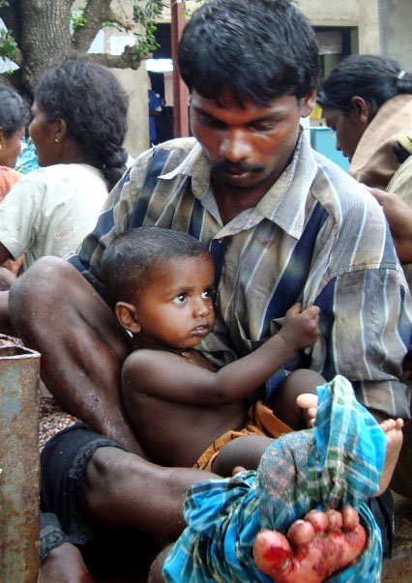
The Crime & Context
“I see the world as utterly dangerous, that it’s a very tenuous, accidental world and what you love, especially the people you love, can be swept away in an instant.”
A war waged on three fronts by its own people against its own people
Anil to focus on one crime: the murder of Sailor - “representative of all those lost voices. To give him a name would name the rest”
“Every side was killing and hiding the evidence. Every side…So it’s secret gangs and squads”

Slide 20
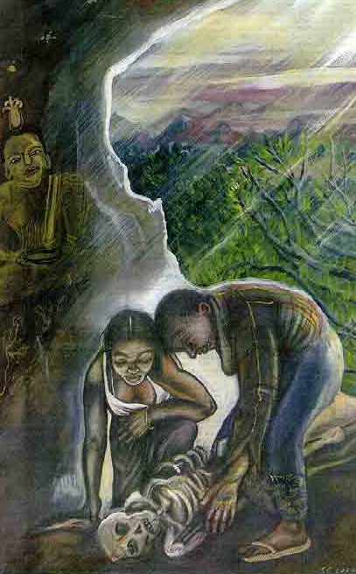
The Investigation
Investigation of the death of so many Sri Lankans is initiated by an international human rights group
Anil and Sarath employ forensic science and art to investigate when and how the murders were committed, and Sailor’s identity
Thwarted by government officials and those people who do not want the perpetrators exposed
Sarath becomes the victim of the drive to silence the stories and stop further investigations

Slide 21
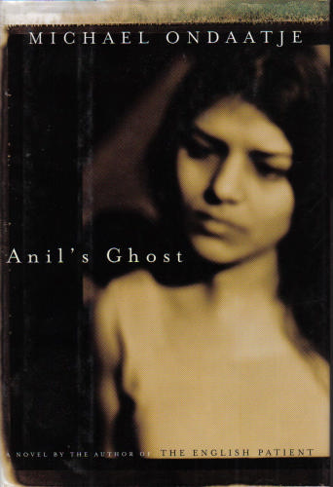
The Detective
In modern times, the female forensic sleuth has grown in popularity
Anil fits the detective profile: she is a flawed loner - her family is dead, she has discarded a husband and a lover; but she is honorable and determined to uncover the truth and seek justice – “We use the bone to search for it.” “The truth shall set you free.”
Anil is independent, resolute, highly skilled, intelligent and strong, but even she cannot bring to justice the perpetrators of a crime that is too extensive and entrenched.

Slide 22
Constants & Differences
The Setting: Sri Lanka may be a country, but it is isolated by the Government’s cone of silence and the west’s indifference.
Closure: There is an unexpected ending and no real closure as the crimes will not end. Solace and hope are found in the redemptive powers of art. The reader is warned from the beginning that there will be no justice: “Nobody at the Centre for Human Rights was very hopeful about it.”; "I see the poem or the novel ending with an open door." Ondaatje

Slide 23
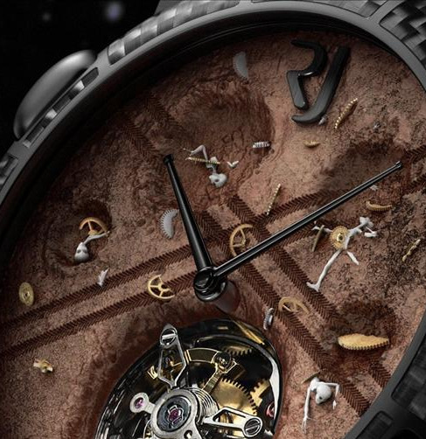
The Ideas
Truth: “There are various versions of the truth.” Ondaatje explores public and private truth. Those in power own public truth; it can be shaped, twisted and distorted at will.
The power of story telling: “...he wanted to tell the story of that place. It would emerge out of this dark trade with the earth.”
Humanity’s inhumanity: The terrible, senseless internecine crimes are inexplicable – all of humanity is guilty and capable of committing dark crimes - “We do it to ourselves.”
Apathy & Ignorance: The West ignored what happened in Sri Lanka, “That’s enough reality for the West”

Slide 24
The Ideas
Healing power of nature: The beautiful images of nature are juxtaposed with the disconcerting images of suffering and death.
The value and beauty of art and culture: Art is a redemptive act that symbolises the wonder and skill of humanity – “not just a culture of death, it’s an intricate, subtle, and artistic culture. I wanted to celebrate it.”
Danger of Ideology: Gamini as a doctor who has spent countless hours trying to save lives, is cynically aware of the terrible consequences of strong ideology when people believe what they are doing is right and that war justifies the end result

Slide 25
The Values
Ondaatje rejects the war and aggression as he is disturbed by its impact on the lives of the innocent people who are ignored by nations. Their voices have been silenced and they have chosen passive acceptance so try to survive. He has stated that his core values are reconciliation, compassion and forgiveness. These are the values of a pacifist who rejects ardent ideology and the abuse of power.
Truth: “Truth sometimes can be, you know, as dangerous as falseness.”

Slide 26
The Values
Pacifism: Acts of violence are viewed by Ondaatje as destructive and dehumanising for all players - “It is much more difficult to be a pacifist than it is to be a man of action…Pacifism, reconciliation, forgiveness are easily mocked and dismissed words. But only those principles will save us.”
Compassion: Caring for others is paramount in this novel. The doctors despite hardship and danger stay to help the victims of war. Gamini works long, arduous hours to ease suffering and save lives.

Slide 27
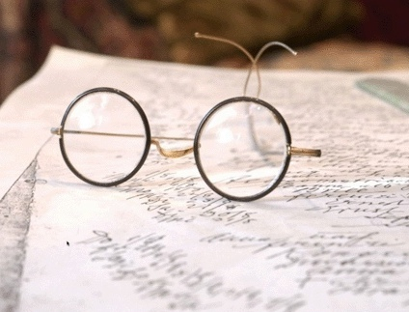
The Craft
Poetic, lyrical and suggestive
Polyphony: “You cannot rely on just Anil to tell the truth, or just Gamini, or just Sarath, or just Palipana, or just Ananda, or whoever it is, to have the only voice.”
Gaps, silences and understatements – the vignettes: “The colour of a shirt. The sarong’s pattern. The hour of disappearance”
Self-reflexivity: Intrudes with political statements and insightful observations of life, art and people, often through Gamini - “Who sent a thirteen-year old to fight, and for what furious cause? For an old leader? For some pale flag?”

Slide 28
The Craft
Structure is chaotic and non-linear and cinematic, employing flashbacks, jump cuts form one scene to another, fractured sentences – “You can't enter my novel with any sureness of where you are going to go.”
Use of intertextuality, historical facts and actual place names adds authenticity further evoking horror.

Slide 29
Anil’s Ghost - Thesis
The detective in crime writing offers hope that justice and truth will prevail.
Anil blindly pursues truth believing that by discovering Sailor’s identity and that of his killers, the there will be some form of justice for all those whose voices have been silenced: “We use the bone to search for it. ‘The truth shall set you free.’ I believe that.” However, she cannot bring to justice the perpetrators of a crime that is too extensive and unstoppable. “Every side was killing and hiding the evidence.”
Sarath challenges Anil’s relentless pursuit: "The truth can be like a flame against a lake of petrol.“
Palipana: "Most of the time in our world, truth is just opinion."

Slide 30
Anil’s Ghost - Thesis
Crime writing’s increasing popularity can be attributed to its exploration of the dark side of humanity and our increasing vulnerability.
Ondaatje persuades the reader to consider how all of humanity is guilty and capable of committing dark crimes. “We do it to ourselves.” (p. 140)
“Every side was killing and hiding the evidence. Every side…So it’s secret gangs and squads.” (p. 17) Everyone to some extent is guilty whether it is through killing, indifference or silence, “Now we all have blood on our clothes.” (p. 48)
“Yet the darkest Greek tragedies were innocent compared with what was happening here. Heads on stakes. Skeletons dug out of a cocoa pit in Matale” (p. 11).

Slide 31
Anil’s Ghost - Thesis
The currency and realism of crime writing makes it the ideal vehicle to challenge our way of thinking about society and humanity.
Ondaatje as a post modernist challenges fervent ideology.
Gamini who has spent countless hours trying to save lives, is cynically aware of the terrible consequences of strong ideology when people believe what they are doing is right, and that war justifies the end result, “He turned away from every person who stood up for a war. Or the principle of one’s land, or pride or ownership, or even personal rights. All of those motives ended up somehow in the arms of careless power. One was no better no worse than the enemy.” (p. 119) and “The way the terrorists in our time can be made to believe they are eternal if they die fighting for the cause of their ruler.” (p. 261)

Slide 32
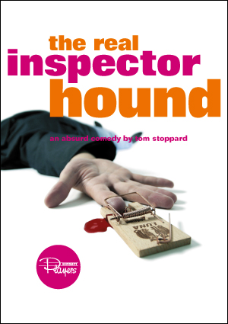
The Real Inspector Hound
As The Real Inspector Hound is a refinement text it is able to successfully parody established and well known conventions of the crime fiction genre – the British cozy.
Stoppard aware of the popularity and longevity of Christie’s play, playfully questions its place in a chaotic modern world in the midst of the futile Vietnam War, and transforms the genre into a melodramatic comedy.
“…the author has taken the trouble to learn from the masters of the genre. He has created a real situation, and few will doubt his ability to resolve it with a startling denouement. Certainly that is what it so far lacks, but it has a beginning, a middle and I have no doubt it will prove to have an end.” (Birdboot p. 31)

Slide 33
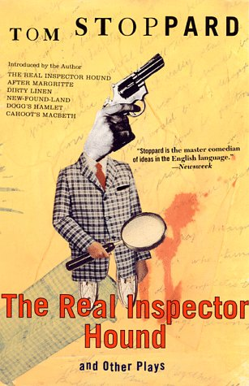
The Form
“It’s a whodunit, man!”
“Parody is repetition, but repetition that includes difference. It is imitation with critical ironic distance, whose irony can cut both ways” (Linda Hutcheon, 1985)
Post-modern, playful parody of the Golden Age cosy confronts us with the clichéd conventions and stereotypical characters of the genre.

Slide 34
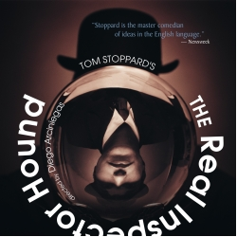
The Form
“Dislocation of an audience’s assumptions is an important part of what I like to write” (Stoppard)
Use of the mirror, the explicit stage directions and the merging of the two plays challenge the audience to ponder why we are drawn to this genre and how even when it is entertaining and humorous we cannot ignore the darker side of humanity.

Slide 35
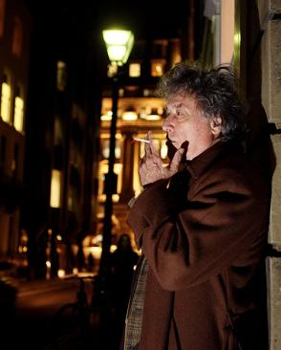
The Writer
“Prufrock (a poem by Eliot) and Beckett are the twin syringes of my diet, my arterial system.”
Influenced by the Absurdists
Postmodernist who rejects ideology
Between 1962-1963 he worked as a theatre critic in London for Scene magazine under the by-line William Boot

Slide 36
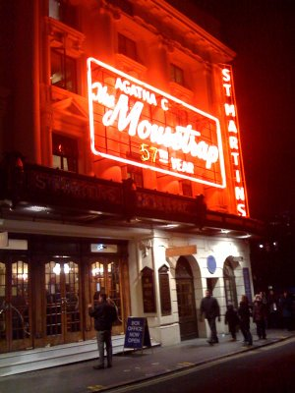
Crime and Context
Stoppard aware of the popularity and longevity of Christie’s play, playfully questions its place in a chaotic modern world in the midst of the futile Vietnam War in the late 1960’s
A number of guests who were all revealed as having a motive to commit the crime - “One of us ordinary mortals thrown together by fate and the elements, is the murderer!”

Slide 37
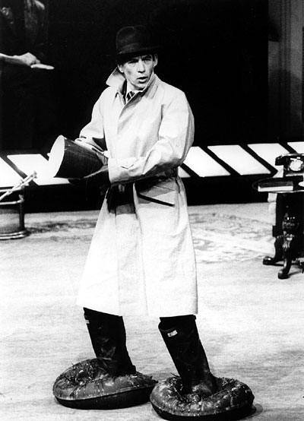
The Investigation & the Detective
Title with its emphasis on ‘real', questions from the start the role of the detective
What disconcerts the audience is that the detective is the killer and the crime is not neatly solved.
The absence of a detective subverts and mocks the conventions of the British cosy that relied on the detective to restore order and ensure that there is justice.
In the world of the 1960’s with the Vietnam War and political unrest, the world is not rational.

Slide 38
Constants & Differences
Conventions: Parodic and intertextual
Setting: Isolated but a setting within a setting
Crime: A murder has already been committed but what is the crime?
Closure: Does occur but there is no justice

Slide 39
Ideas
Wish fulfilment: Stoppard playfully exposes the dangers of pursuing our deepest desires and wishes. Birdboot considers it his right to seduce young actresses. Moon’s envy and desire to be the main theatre critic are exaggerated in the play, “Sometimes I dream that I killed him.” Ironically his desires are ruthlessly pursued by his third stinger Puckeridge who realises his ambitions through murder: “Puckeridge…you cunning bastard.”
Hypocrisy: Birdboot justifies his affairs with the actresses, and boasts about his ability to launch the career of an actress

Slide 40
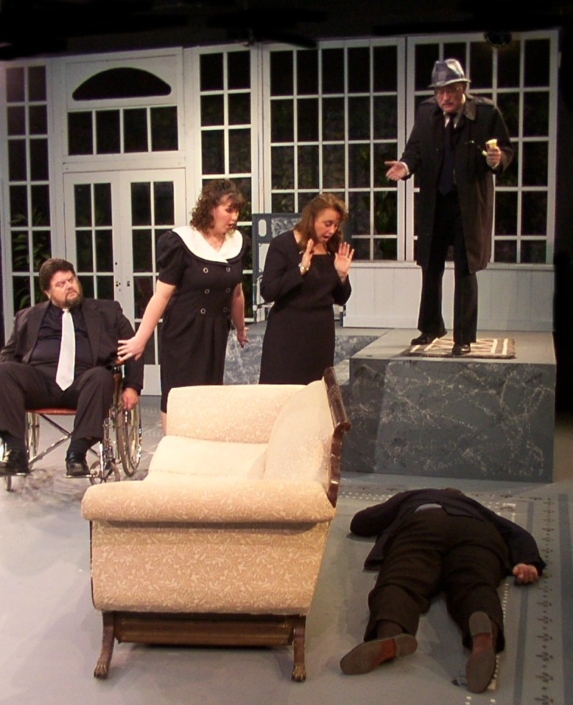
Values
Communication: The critics in the play talk but they do not communicate. Their egocentric, asinine comments are hollow and meaningless. The Absurdist banter of the characters on stage is equally spurious and superficial.
Integrity and Honesty: Neither the characters or the critics reveal integrity.
Truth and Honesty: Stoppard’s later plays are political and focused on exposing the absence of truth in society. In this play, Stoppard satirises reality and truth.

Slide 41
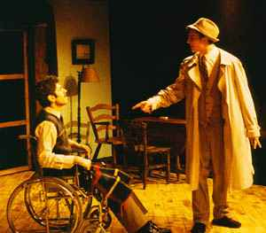
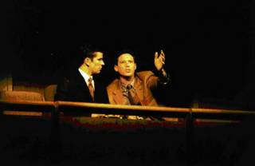
Craft
Entertaining, melodramatic parody of the popular and very familiar British cosy.
“Parody is repetition, but repetition that includes difference. It is imitation with critical ironic distance, whose irony can cut both ways” (Linda Hutcheon).
Refinement of the genre enables writers like Stoppard to play with the conventions

Slide 42
The Craft
Employs the stock features of melodrama: slapstick humour, hyperbole, stereotypical characters and double entendre to effectively mock the conventions of the cosy
Play within a play and the mirror - “Dislocation of an audience’s assumptions is an important part of what I like to write.”

Slide 43
The Real Inspector Hound - Thesis
Subversive texts challenge the dominant ideological discourse.
The play relies on the audience’s prior knowledge of a cosy: the isolated setting, the usual suspects, the red herrings; however, the parody challenges the audience’s assumptions about the genre.
The play is takes the very traditional cosy and hammers it with melodrama and slapstick humour; however, Stoppard fails to realise that the success of Christie’s play lies in its use of light-hearted parody.

Slide 44
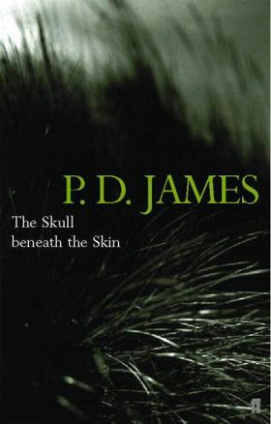
The Skull Beneath the Skin
“I think that’s one of the attractions of the genre, that it does bring order out of disorder…It affirms the sanctity of life, however unpleasant that character may be, and it confirms our belief that we live in a moral and compassionate universe. And that we can have some justice, even if it is the imperfect justice of men” P.D. James.
Young female private investigator who can be naïve and inept.
Draws on the cosy puzzle litters the pages of the novel with various clues and red herrings for the reader to discover the identity of the murderer before Cordelia solves the mystery.
Like Stoppard, James mocks the cosy's clichés and melodrama.

Slide 45
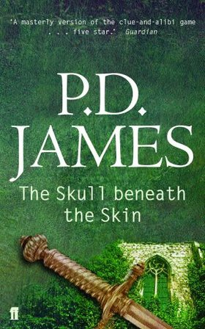
The Form
P.D.James has created a hybrid crime fiction novel that blends the conventions of gothic horror and the cosy.
She metafictionally mocks the crime genre - “It sounds like the chapter heading for one of those thirties snobbish thrillers”

Slide 46
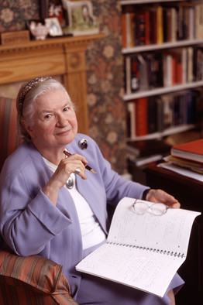
Writer
Context of the early 1980’s when the individual was becoming more important than the community and the family unit.
P.D. James is attracted to the detective story by “the catharsis of carefully controlled terror, the bringing of order out of disorder, the reassurance that we live in a comprehensible and moral universe and that, although we may not achieve justice, we can at least achieve an explanation and a solution.”

Slide 47
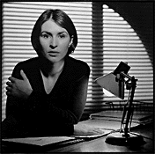
The Detective
P.D. James has crafted an appealing, inexperienced and vulnerable detective in Cordelia Gray - “How sweet she was, with that gentle, self-contained dignity”
She is alone like Anil and Jeff with an uneasy past – she was placed in foster care by her Marxist father - “She guarded her privacy”
Her innocence and strong sense of justice and integrity mark her as an outsider in a corrupt and tainted world - ‘‘I can’t believe that a human being could be so evil.”

Slide 48
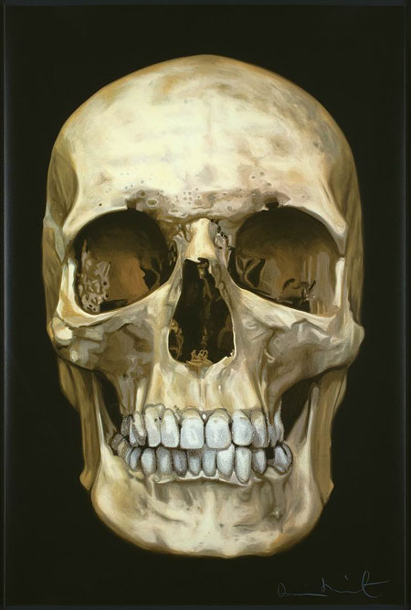
Ideas
Evil: Cordelia is shocked by the dark side of humanity that is capable of so much evil:
Egocentricity: Clarissa’s selfishness and cruelty shocks Cordelia who finds it difficult to work as her private investigator - “Clarissa doesn’t understand about guilt”
Fear of Death: The title signifies our mortality and our fear of death. Clarissa continually focuses on dying, Ivo is dying from cancer, and Gorringe morbidly satisfies his fascination by surrounding himself with artefacts of death – “There never was a time when I didn’t see the skull beneath the skin.”

Slide 49
Values
Justice: James asserts that murder is never justifiable; however, Ambrose is not brought to justice: “It affirms the sanctity of life, however unpleasant that character may be, and it confirms our belief that we live in a moral and compassionate universe. And that we can have some justice, even if it is the imperfect justice of men”
Altruism: Despite running a struggling agency she continues to employ misfit characters. Her unselfishness is juxtaposed with Clarissa’s egocentric, uncaring attitude and behaviour.

Slide 50
Craft
The isolated setting with the Victorian mansion that has gothic features marries the two genres in this hybrid text – “Setting, important in any work of fiction …It establishes atmosphere, influences plot and character and enhances the horror of murder, sometimes by contrast between the beauty and outward peace of the scene and the turbulence of human emotions.”
Characters are very deliberately drawn with detail - “The characters should be real human beings, each of whom comes alive for the reader, not pasteboard people to be knocked down in the final chapter."

Slide 51
The Skull Beneath the Skin - Thesis
The continued popularity of the crime writing has been assured by the emergence of subversions.
“I've tried to use the well-worn conventions of the mystery and subvert them, stretch them, use them to say something true about my characters, about men and women and the society in which they live” P.D. James.
The detective Cordelia Gray has an uneasy past and she lacks the intellectual capacity of the traditional cosy detective.
The isolated setting at Sir Ambrose Gorringe's Victorian castle is a convention of the cozy but the blending of the cozy with the gothic genre is a subversion: “It stood on the edge of the sea, almost as if it had risen from the waves, a castle of rose-red brick…” (p. 69).

Slide 52
The Skull Beneath the Skin - Thesis
The continued popularity of the genre has been assured by the emergence of subversions.
Parody and self-reflexity: James mocks the cozy genre: “We are all here together, the of us on this small and lonely island. And one of us is a murderer.” “Reviewing Agatha Christie at the Vaudeville is a poor preparation for the real thing.”

Slide 53
The Skull Beneath the Skin - Thesis
One of the key attractions of crime writing is humanity’s obsession with mortality.
The title signifies our mortality and our fear of death: Clarissa: “I don’t remember when it began, but I knew the facts of death before I knew the facts of life. There never was a time when I didn’t see the skull beneath the skin.”
“But in all societies there was an atavistic fear of the malevolent power of a secret adversary, working for evil, willing one to failure, perhaps to death” (p. 60).
Clarissa continually focuses on dying, Ivo is dying from cancer, and Gorringe morbidly satisfies his fascination by surrounding himself with artefacts of death. “It’s my death I’m afraid of” (Clarissa, p. 123).

