Slide 1
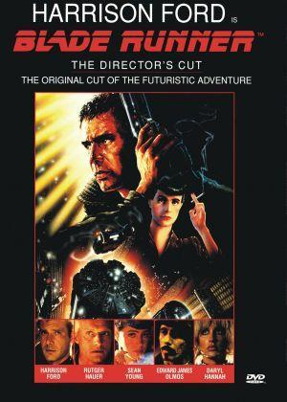
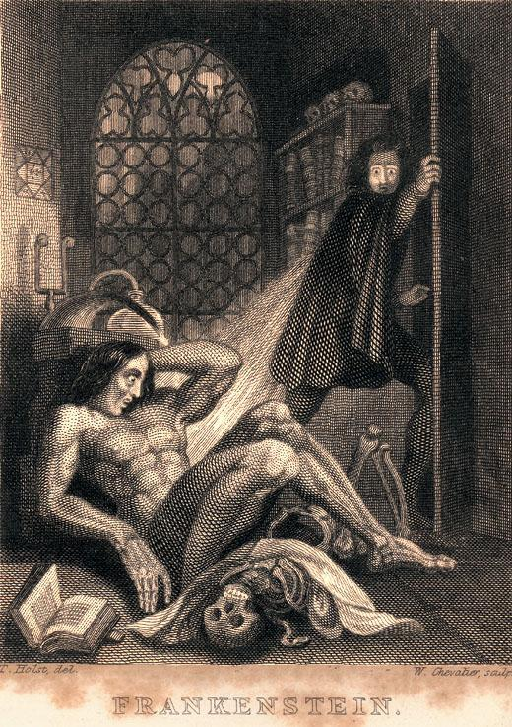
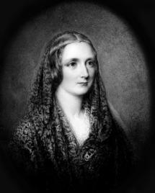
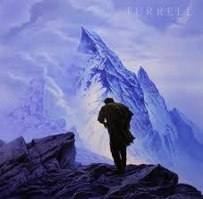
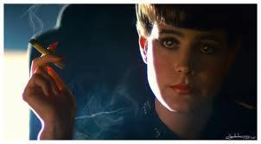
Moduel
Module A: Comparative Study of Texts and Contexts
Elective 2: Texts in Time
Good Samaritan Catholic College English
Notes:
*

Slide 2
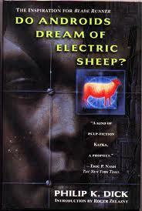
Module A: Comparative Study of Texts and Contexts Concepts
Comparative Study
Texts are compared in order to explore them in relation to their contexts.
Contextualisation:
The effects of social, historical and cultural context and questions of value in texts.
Value:
A quality desirable as a means or an end in itself (noun)
To estimate or assign worth to a text (verb)
Notes:
*

Slide 3
Elective 2:Texts in Time Rubric
In this elective students:
compare how the treatment of similar content in a pair of texts composed in different times and contexts reflect changing values and perspectives
come to a heightened understanding of the meaning and significance of each text
consider texts in their contexts, compare values, ideas, language forms and features

Slide 4
HSC Examination Rubric
In your answer you will be assessed on how well you:
demonstrate understanding of the meanings of a pair of texts when considered together
evaluate the relationships between texts and contexts
organise, develop and express ideas using language appropriate to audience, purpose and form

Slide 5
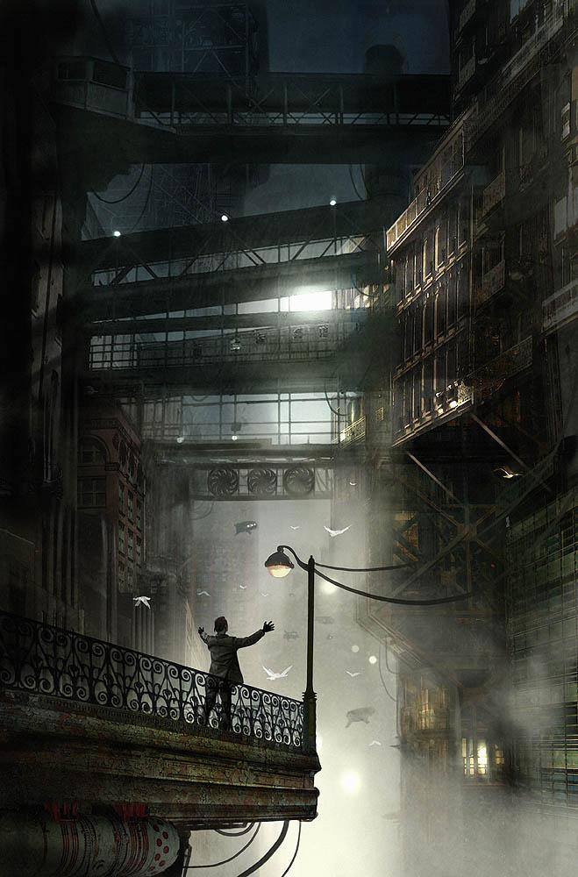
Comparisons
Look through the lens of the film when you explore the novel and compare the texts considering how different times and contexts reflect changing values and perspectives

Slide 6
Module A: Key Ideas
In what ways does a comparative study accentuate the distinctive contexts of Frankenstein and Bladerunner?
The question will require you to consider the treatment of similar content in your comparative study of the pair of texts
Consider the specific compositional times and contexts of each text and explore their impact in reflecting changed values and perspectives upon ideas and concepts.
Study the ideas, characterisation, plot, setting etc through an integrated analysis of the interplay between the two texts and a consideration of how meaning is conveyed.
Notes:
*

Slide 7
Comparing Texts
Frankenstein
Bladerunner
Gothic horror novel but considered a precursor of the science fiction genre
Published in 1818, a time of social/political upheaval and intellectual revisionism known as the Romantic movement
Mary Shelley was inspired by this context
Dystopic postmodern film based on Phillip K Dick’s 1968 novel Do Androids Dream of Electronic Sheep?
Ridley Scott uses film noir conventions to create an atmosphere of oppression, surveillance, control, slavery and violence.
Ridley Scott critiques modern society and is anti technology

Slide 8
Notes from the Marking Centre
Candidates considered how a comparative study highlighted composers’ contexts.
Better responses produced a sustained response, developing a thesis that genuinely addressed the question using a discerning selection of textual references
Better responses developed a thesis which demonstrated a strong conceptual understanding of the module and the elective.
Weaker responses tended to identify some similarities or differences between the texts, often with a limited understanding of their significance.
Notes:
*

Slide 9
Introductory Activity Texts in Time
Go to http://www.articlemyriad.com/elements-romanticism-frankenstein/
Read the article and make notes on the following:
In your own words outline some of the key ideological underpinnings of the Romantic movement
What did the Romantics believe would be the legacy of individual and collective visual imagination?
Why is the physical place and environment significant in locating the events of the text?
How is the novel concerned with the exploration of the limitation of boundaries?
Notes:
*

